Slide 1
Computational Evaluation of Horoscopes
Mohammed Guiga (Capricorn), Kelsey Neis (Capricorn),
Sai Sharan Sundar (Cancer), Josh Spitzer-Resnick (Pisces)
CSCI 5523, Fall 2021, Group 6

Slide 2
Motivation - why horoscopes?
Have you ever wondered if the horoscopes you find online are actually about you or if they’re just general enough that anyone can find *something* relatable in them? Does this really mean anything?
*~*~*~oooh controversial~*~*~*
We set out to see if we could find similarities between horoscopes and differences across signs using natural language processing techniques. Can we classify horoscopes by sign?
Dataset: 21,960 horoscopes from Horoscope.com from June 16th 2020 - June 16th 2021

Slide 3
Challenges & limitations
None of us are experts in horoscopes or astrology in terms of knowing what patterns to search for
Only 1 year of horoscopes - not able to reliably identify any possible time-based patterns, eg:
Does sentiment in horoscopes change during a sign’s month?
Is there a day-of-the-week pattern for some signs?
Dataset taken from only one source - could overfit to their style/practices of writing horoscopes, may not be representative of all horoscopes

Slide 4
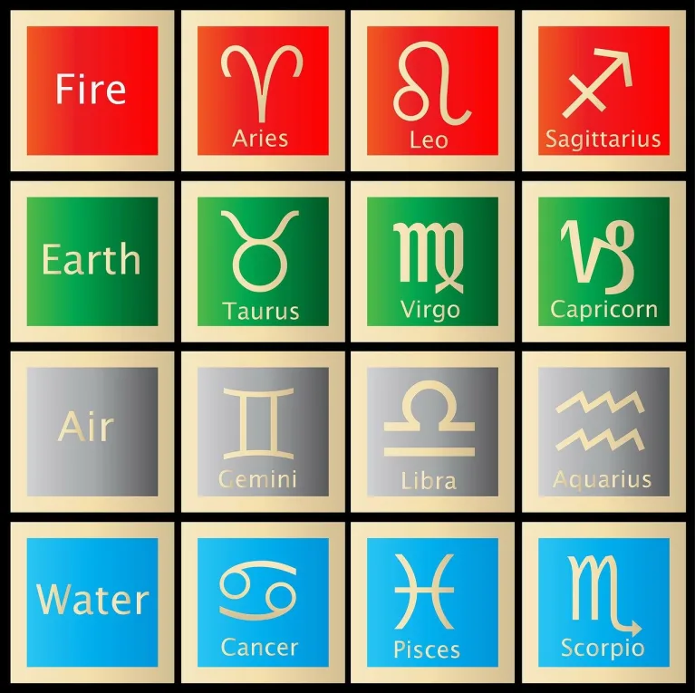
Some horoscope background
12 signs: aries, taurus, gemini, cancer, leo, virgo, libra, scorpio, sagittarius, capricorn, aquarius, pisces
4 elements associated with signs: fire, earth, air, water
Different (supposedly?) horoscope text written for each sign on each day
Horoscopes can also have different themes (eg: general, love, career, wellness, birthday)

Slide 5
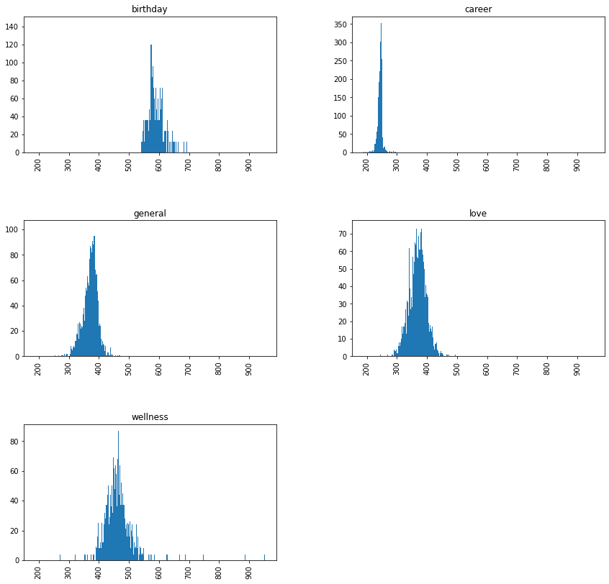
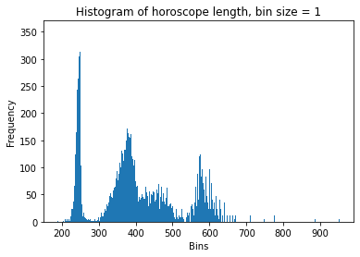
Exploratory analysis - some findings
5 kinds of horoscopes: general, love, career, wellness, birthday
Each of these has different distribution of words, consistent across signs
Many horoscopes are repeated on different days - of 21,960:
109 repeated for the same sign
9909 repeated for the same category, different sign

Slide 6
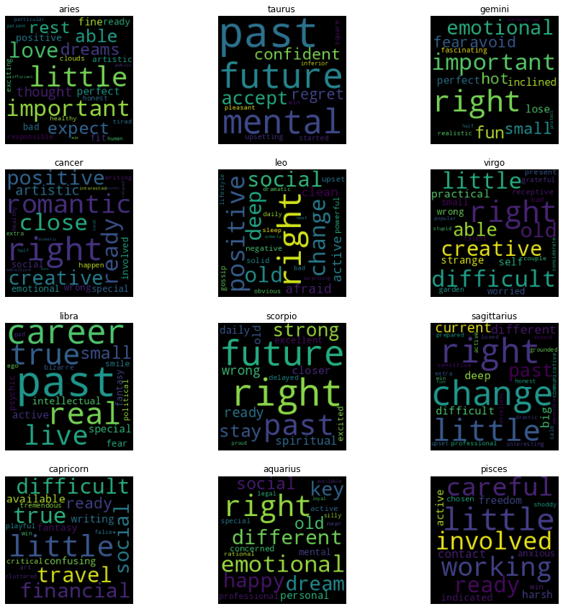
Exploratory analysis cont.
Top words after preprocessing looked almost identical across signs
Use NLTK* Part of Speech (PoS) tagging
Tried different combinations of adjectives, verbs, nouns, and adjectives seem to differentiate the signs best
*Python package: Natural Language Toolkit

Slide 7
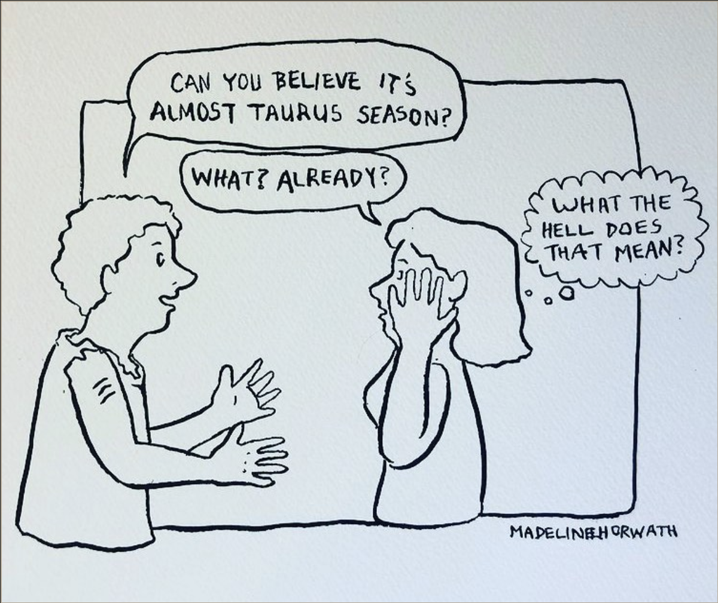
Exploratory analysis cont.
Comic credit: @MadelineHorwath

Slide 8
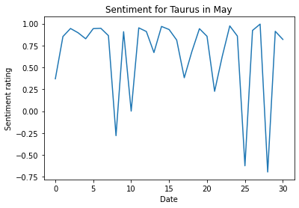
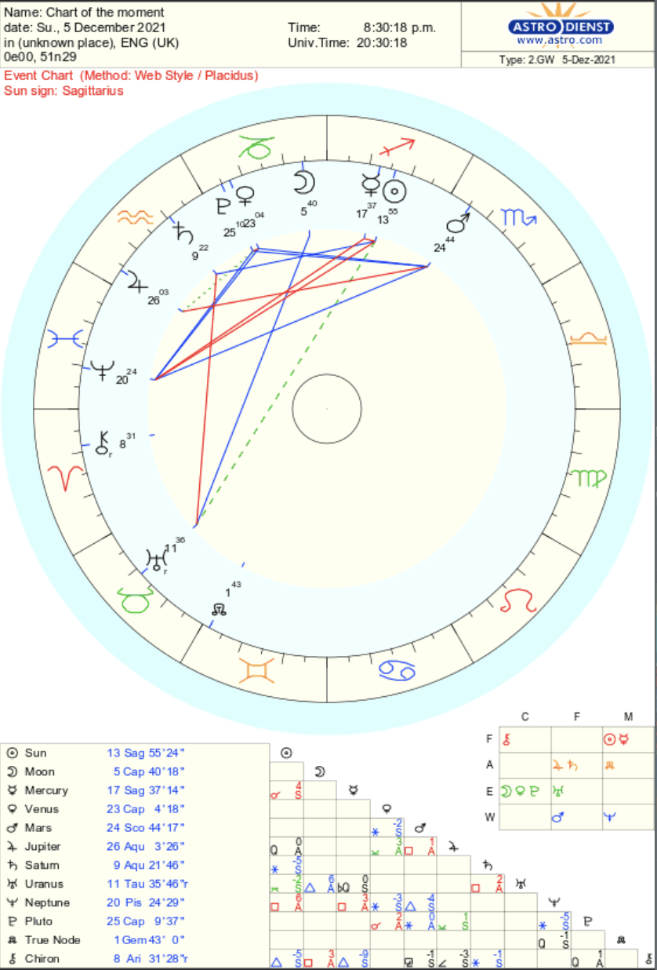
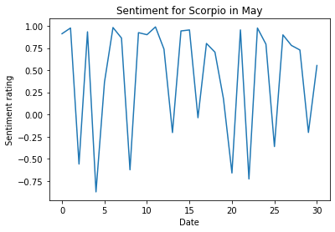
Sentiment analysis
Outlooks should vary based on positions of planets and stars
Compare two opposite signs
Sentiment scores: VADER
Next steps: compare with planetary positions
Example: if Mars is in Scorpio’s range, expect positive sentiment, if Venus is, expect more negative

Slide 9
Preprocessing
Standard
lowercase
remove special characters
remove stopwords (common words that don’t add significant meaning)
Special for this case: remove words that may indicate what sign this is being written about, eg:
name of month
name of sign

Slide 10
Some models we tried so far
Multinomial Naive Bayes
Logistic Regression
Random Forest
Linear SVC
Sequential Model with Dense Layers
Sequential Model with LSTM and Dense Layers

Slide 11
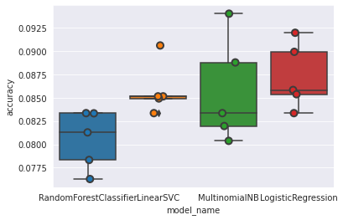
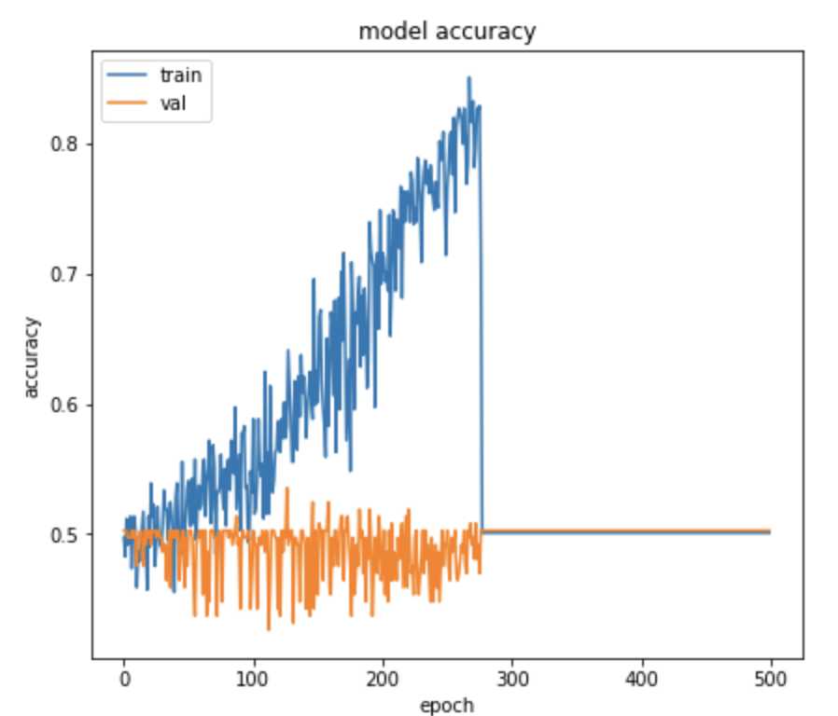
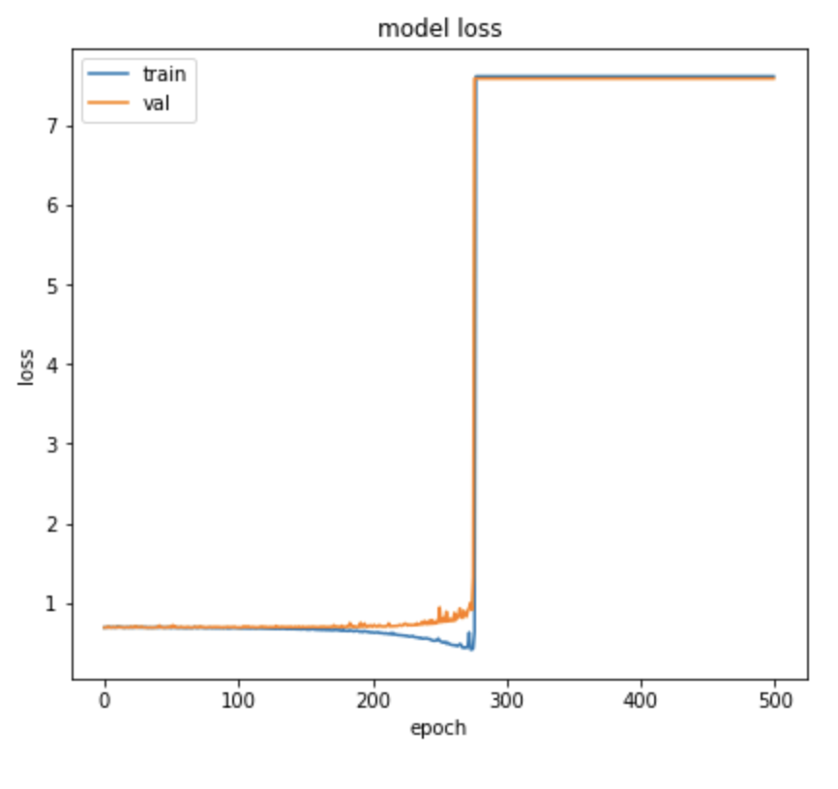
Wow these results suck, what does that mean?
Naive Models
Sequential Model with Dense Layers

Slide 12
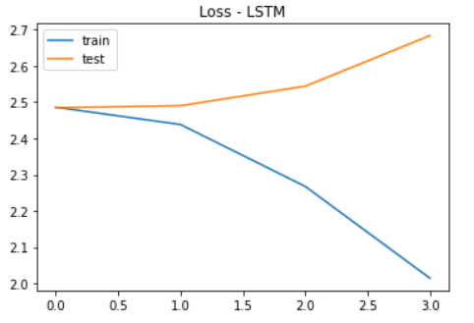
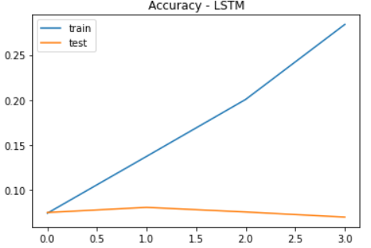
Wow these results suck, what does that mean?
Sequential Model with LSTM and Dense Layers

Slide 13
In conclusion - so far
Exploratory analysis suggests that the horoscope written just for you has likely (almost 50% chance) been used for another sign already
Need to do more work on sentiment analysis to determine if differences are random or have some meaning
So far, models we’ve tried with NLP techniques have failed to be able to distinguish between horoscope signs
The neural networks’ validation accuracies are consistently approximately equal to the probability of guessing a zodiac sign, i.e., 1/12 = 0.083

Slide 14
Some things we want to try going forward
Try to distinguish between element of horoscope rather than individual horoscope
Try with just adjectives used in horoscopes
Compare to descriptions of signs rather than other horoscopes
Introduce GPU utilization techniques to train network for higher epochs
Build deeper neural networks
Notes:
Compare to descriptions of signs rather than other horoscopes - compare similarity between descriptions of signs (adjectives)

Slide 15
References & credits
Data set, https://www.kaggle.com/shahp7575/horoscopes
Exploratory analysis on text data, https://medium.com/swlh/text-summarization-guide-exploratory-data-analysis-on-text-data-4e22ce2dd6ad
Text preprocessing, https://towardsdatascience.com/the-hottest-topics-in-machine-learning-866ae21ba22d
Cleaning and preprocessing text, https://towardsdatascience.com/nlp-for-beginners-cleaning-preprocessing-text-data-ae8e306bef0f
Speech and Language Processing, https://web.stanford.edu/~jurafsky/slp3/ed3book_sep212021.pdf
Astrology wiki, https://www.astro.com/astrology/in_intro_e.htm?
More on Astrology, https://www.astrology.com/
Horoscope webcomic (with permission), https://www.instagram.com/p/CVgFu95p1jU/
LSTM Implementation, https://towardsdatascience.com/multi-class-text-classification-with-lstm-1590bee1bd17
Sequential Model Implementation

Slide 16
Humans 1, machine 0

